Slide 1

Transport Operations
CHAPTER 38

Slide 2
National EMS Education Standard Competencies (1 of 4)
EMS Operations
Knowledge of operational roles and responsibilities to ensure patient, public, and personnel safety.
Notes:
National EMS Education Standard Competencies
EMS Operations
Knowledge of operational roles and responsibilities to ensure patient, public, and personnel safety.

Slide 3
National EMS Education Standard Competencies (2 of 4)
Principles of Safely Operating a Ground Ambulance
Risks and responsibilities of emergency response
Risks and responsibilities of transport
Air Medical
Safe air medical operations
Criteria for utilizing air medical response
Notes:
National EMS Education Standard Competencies
Principles of Safely Operating a Ground Ambulance
• Risks and responsibilities of emergency response
• Risks and responsibilities of transport
Air Medical
• Safe air medical operations
• Criteria for utilizing air medical response

Slide 4
National EMS Education Standard Competencies (3 of 4)
Medicine
Applies fundamental knowledge to provide basic emergency care and transportation based on assessment findings for an acutely ill patient.
Notes:
National EMS Education Standard Competencies
Medicine
Applies fundamental knowledge to provide basic emergency care and transportation based on assessment findings for an acutely ill patient.

Slide 5
National EMS Education Standard Competencies (4 of 4)
Infectious Diseases
Awareness of
  How to decontaminate equipment after treating a patient
  How to decontaminate the ambulance and equipment after treating a patient
Notes:
National EMS Education Standard Competencies
Infectious Diseases
• Awareness of
• How to decontaminate equipment after treating a patient
• How to decontaminate the ambulance and equipment after treating a patient

Slide 6
Introduction
Today’s ambulances are stocked with standard medical supplies.
  Many are equipped with state-of-the-art technology that transmit data directly to the emergency department.
Today’s emphasis on rapid response places the EMT in greater danger.
Notes:
Lecture Outline
Introduction
A. Today’s ambulances are stocked with standard medical supplies, and many are equipped with state-of-the-art technology that can transmit data directly to the emergency department.
B. Today’s emphasis on rapid response places the EMT in greater danger while driving to calls.

Slide 7
Emergency Vehicle Design (1 of 5)
An ambulance is a vehicle that is used for treating and transporting patients who need emergency medical care to a hospital.
Today’s ambulance designs are based on NFPA 1917, Standard for Automotive Ambulances, and suggestions from the industry.
Notes:
Lecture Outline
II. Emergency Vehicle Design
A. An ambulance is a vehicle that is used for treating and transporting patients who need emergency medical care to a hospital.
B. Today’s ambulance designs are based on NFPA 1917, Standard for Automotive Ambulances, and on suggestions from the ambulance industry and from EMS personnel.

Slide 8
Emergency Vehicle Design (2 of 5)
Components of the modern ambulance:
  Driver’s compartment
  Patient compartment big enough for two EMTs and two supine patients
  Equipment and supplies
  Two-way radio communication
  Design for maximum safety, efficiency, and comfort
Notes:
Lecture Outline
C. Components of the modern ambulance:
1. Driver’s compartment
2. Patient compartment big enough for two EMTs and at least one supine patient.
a. Additional patients may be seated on a bench seat or swivel seat with appropriate safety restraints.
3. Equipment and supplies to provide emergency medical care at the scene and during transport, to safeguard personnel and patients from hazardous conditions and to carry out light extrication procedures.
4. Two-way radio communication
5. Design and construction that ensure maximum safety, efficiency, and comfort

Slide 9
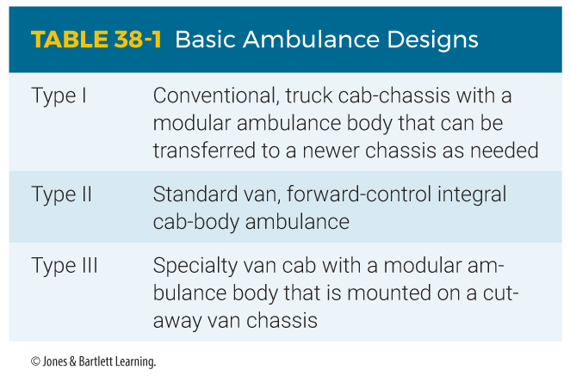
Emergency Vehicle Design (3 of 5)
Notes:
This table shows the basic ambulance designs.

Slide 10
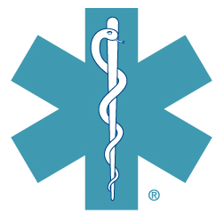
Emergency Vehicle Design (4 of 5)
Ambulance licensing or certification standards are established by states.
The Star of Life® emblem is affixed to the sides, rear, and roof of the ambulance.
FIGURE 38-5 The Star of Life.
Courtesy of National Highway Traffic Safety Administration.
Notes:
Lecture Outline
D. Each state establishes its own standards for ambulance licensing or certification.
1. Many states use federal specifications.
E. The Star of Life® emblem identifies vehicles as ambulances, and is often affixed to the sides, rear, and roof of the ambulance.

Slide 11
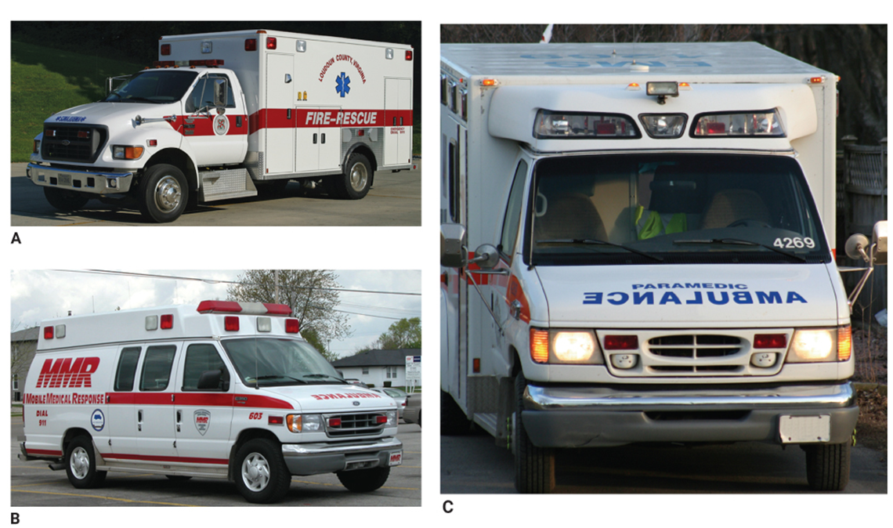
Emergency Vehicle Design (5 of 5)
FIGURE 38-4 A. The conventional, truck cab-chassis has a modular ambulance body that can be transferred to a newer chassis (type I). B. The standard van ambulance has a forward-control integral cab body (type II). C. The specialty van ambulance has a cab that is mounted on a cut-away van chassis (type III).
A: © Jones & Bartlett Learning; B: Courtesy of Captain David Jackson, Saginaw Township Fire Department; C: © Kevin Norris/ Shutterstock.
Notes:
These figures show the different types of ambulances.

Slide 12
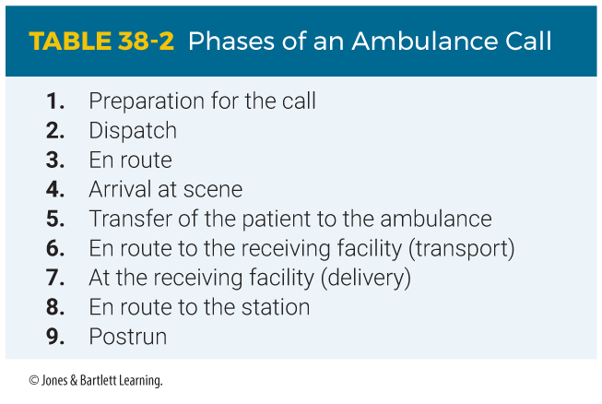
Phases of an Ambulance Call
Notes:
Lecture Outline
III. Phases of an Ambulance Call
A. An ambulance call has nine phases:
1. Preparation
2. Dispatch
3. En route
4. Arrival at scene
5. Transfer of patient to ambulance
6. En route to receiving facility (transport)
7. At receiving facility (delivery)
8. En route to station
9. Postrun

Slide 13
Preparation Phase (1 of 11)
Make sure equipment and supplies are in their proper places and ready for use.
  Store new equipment only after proper instruction on its use and consulting with the medical director.
  Equipment should be durable and standardized.
Notes:
Lecture Outline
B. The preparation phase
1. Make sure equipment and supplies are in their proper places and ready for use
2. New equipment should be placed on an ambulance only after proper instruction on its use and consulting with the medical director.
3. Equipment and supplies should be durable and standardized.

Slide 14
Preparation Phase (2 of 11)
Store equipment and supplies according to how urgently and how often they are used.
  Items for life-threatening conditions at the head of the primary stretcher
  Items for cardiac care, external bleeding, and blood pressure at the side of the stretcher
Notes:
Lecture Outline
Store equipment and supplies in the ambulance according to how urgently and how often they are used.
a. Place items needed for life-threatening conditions within easy reach, at the head of the primary stretcher.
b. Place items for cardiac care, external bleeding control, and monitoring blood pressure at the side of the stretcher.

Slide 15
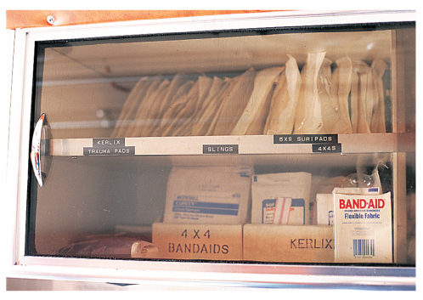
Preparation Phase (3 of 11)
Cabinets and drawer fronts should be transparent or labeled.
FIGURE 38-8 Containers should be placed in
cabinets and drawers with transparent fronts for quick identification.
© Jones & Bartlett Learning. Courtesy of MIEMSS.
Notes:
Lecture Outline
5. Cabinets and drawers should have transparent fronts or be labeled and should open easily and close securely.

Slide 16
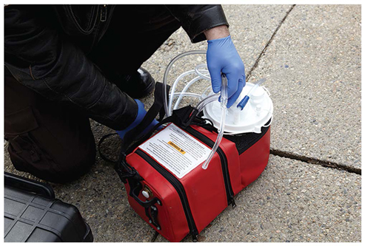

Preparation Phase (4 of 11)
Medical equipment
  Basic supplies
  Airway and ventilation equipment
  CPR equipment
  Basic wound care supplies
FIGURE 38-9 The ambulance should carry both a mounted suctioning unit and a portable unit.
© Jones & Bartlett Learning.
FIGURE 38-11 A CPR board may be carried on the ambulance.
© Courtesy of Ferno Washington, Inc.
Notes:
Lecture Outline
6. Medical equipment
a. Basic supplies
i. Personal protective equipment (PPE) and sharps containers
ii. Airway and ventilation equipment
iii. Basic wound care supplies
iv. Splinting supplies
v. Childbirth supplies
vi. Automated external defibrillator
vii. Patient transfer equipment
viii. Medications
ix. Communication equipment
x. Other regionally appropriate supplies
b. Airway and ventilation equipment
i. Oropharyngeal airways for adults, children, and infants
ii. Nasopharyngeal airways for adults and children
iii. CPAP equipment
iv. Equipment for advanced airway procedures
v. Two portable artificial ventilation devices that operate independently of an oxygen supply.
vi. Bag-mask devices capable of oxygen enrichment and, when attached to an oxygen supply with the oxygen reservoir in place, able to supply almost 100%
vii. Nebulizer masks
xiii. Portable and mounted suctioning units
ix. At least two oxygen supply units: one portable and one installed on board.
c. CPR equipment
i. A CPR board
ii. Mechanical devices that deliver chest compressions and ventilations
d. Basic wound care supplies

Slide 17
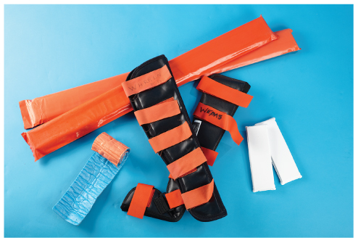
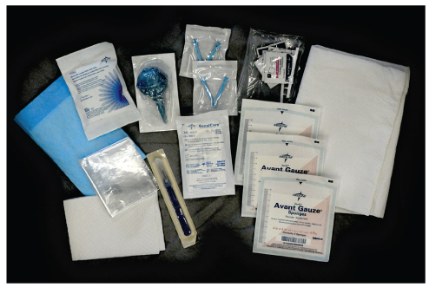
Preparation Phase (5 of 11)
Medical equipment (cont’d)
  Splinting supplies
  Childbirth supplies
  Automated external defibrillator
FIGURE 38-12 Supplies for splinting fractures and
dislocations should be carried on the ambulance.
© Jones & Bartlett Learning
FIGURE 38-13 A sterile emergency obstetric kit must be carried on the ambulance.
© Mark C. Ide.
Notes:
Lecture Outline
e. Splinting supplies
Childbirth supplies
g. Automated external defibrillator (AED)

Slide 18
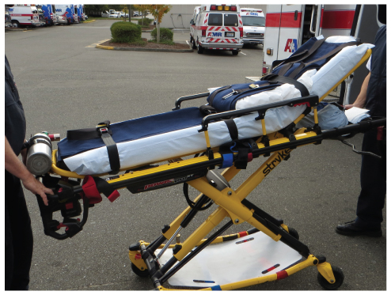
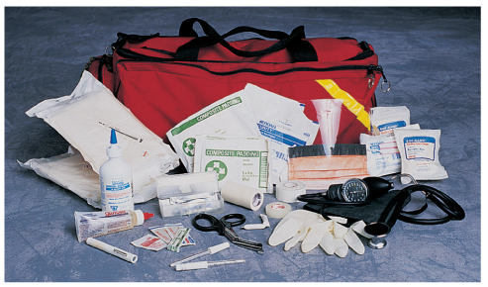
Preparation Phase (6 of 11)
Medical equipment (cont’d)
  Patient transfer equipment
  Medications
  Jump kit
FIGURE 38-15 The wheeled ambulance stretcher should be locked into place at an appropriate height.
Courtesy of Angulo, Raul A.
FIGURE 38-16 A portable jump kit should contain
practically anything you will need during the first 5 minutes with the patient.
© Jones & Bartlett Learning. Courtesy of MIEMSS.
Notes:
Lecture Outline
h. Patient transfer equipment
i. Primary wheeled ambulance stretcher
ii. Wheeled stair chair
iii. Long backboard
v. Short backboard or short immobilization device
i. Medications
j. Jump kit
i. “5-minute kit”: anything needed in the first 5 minutes with the patient, except for the AED

Slide 19
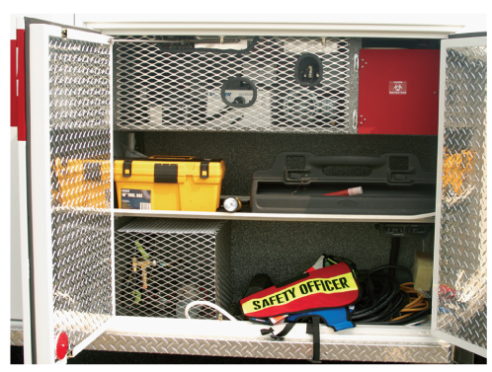
Preparation Phase (7 of 11)
Safety and operations equipment
  Personal safety equipment
  Equipment for work areas
FIGURE 38-17 The ambulance should have a weatherproof compartment that can be reached from outside the patient compartment. It should hold equipment for safeguarding patients and EMTs, controlling traffic, and illuminating work areas.
© Jones & Bartlett Learning. Courtesy of MIEMSS.
Notes:
Lecture Outline
7. Safety and operations equipment
a. Personal safety equipment
b. Equipment for work areas
i. Located in a waterproof compartment outside the patient compartment
ii. Warning devices that flash or have reflectors
iii. Type ABC fire extinguisher, dry chemical, 5-lb minimum
iv. Hard hats or helmets with face shields or safety goggles
v. Portable floodlights, flashlights

Slide 20
Preparation Phase (8 of 11)
Safety and operations equipment (cont’d)
  Preplanning and navigation equipment
  Extrication equipment
Notes:
Lecture Outline
c. Preplanning/navigation guides
i. GPS devices and MDTs are standard equipment in modern ambulances.
ii. Keep detailed street and area maps in the driver’s compartment.
d. Extrication equipment
i. Located in a weatherproof compartment outside the patient compartment
ii. Contains equipment that is needed for simple, light extrication, even if an extrication and rescue unit is readily available

Slide 21
Preparation Phase (9 of 11)
Personnel
  At least one EMT in the patient compartment during transport
  Two EMTs are strongly recommended.
  Some services have a non-EMT driver and a single EMT in the patient compartment.
Notes:
Lecture Outline
8. Personnel
a. At least one EMT in the patient compartment during transport

Slide 22
Preparation Phase (10 of 11)
Perform daily inspections.
  Ambulance inspection
  Inspect the cleanliness, quantity, and function of medical equipment and supplies.
Notes:
Lecture Outline
9. Daily inspections
a. Items included in the ambulance inspection:
i. Fuel, oil, and transmission fluid levels
ii. Engine cooling
iii. Batteries
iv. Brake fluid
v. Engine belts
vi. Inflation pressure of wheels and tires (including the spare) and any signs of unusual or uneven wear
vii. All interior and exterior lights
viii. Windshield wipers and fluid
ix. Horn and siren
x. Air conditioners, heaters, and ventilating system
xi. Ability of doors to open, close, latch, and lock properly
xii. Communication systems, vehicle and portable
xiii. Cleanliness and positions of all windows and mirrors
b. Inspect the cleanliness, quantity, and function of medical equipment and supplies.
i. Test all battery-operated equipment (eg, AED)

Slide 23
Preparation Phase (11 of 11)
Review safety precautions.
  Review traffic safety rules and regulations.
  Ensure safety devices are in working order.
  Properly secure oxygen tanks.
  Properly secure all equipment in the cab, rear, and compartments.
Notes:
Lecture Outline
Safety precautions
a. Review standard traffic safety rules and regulations.
b. Make sure safety devices (eg, seat belts) are in proper working order.
c. Oxygen tanks must be secured by fixed clasps or housings.
d. All equipment in the cab, rear, and compartments must be secured appropriately.

Slide 24
Dispatch Phase (1 of 2)
Dispatch must be easy to access and in service 24 hours a day.
May be operated by the local EMS or by a shared service
May serve only one jurisdiction or may be an area or regional center
Notes:
Lecture Outline
C. The dispatch phase
1. Dispatch must be easy to access and in service 24 hours a day.

Slide 25
Dispatch Phase (2 of 2)
Dispatcher should gather and record:
  Nature of the call
  Name, present location, and call-back number
  Location of patient
  Number of patients and severity of their conditions
  Other pertinent information
Notes:
Lecture Outline
2. The dispatcher should gather and record:
a. The nature of the call
b. The caller’s name, present location, and call-back number
c. The exact location of the patient(s) (most important)
d. The number of patients and the severity of their conditions
e. Other pertinent information

Slide 26
En Route to the Scene
Most dangerous phase for EMTs
Crashes cause many serious injuries.
  Fasten seat belts and shoulder harnesses before moving the ambulance.
Review dispatch information.
Prepare to assess and care for the patient.
Notes:
Lecture Outline
D. En route to the scene
1. In many ways, the en route to the scene phase is the most dangerous phase for EMTs.
2. Crashes cause many serious injuries.
a. Fasten seat belts and shoulder harnesses before moving the ambulance.
3. Review dispatch information.
4. Prepare to assess and care for the patient.
a. Assign specific duties and scene management tasks.
b. Decide which equipment should be taken initially.

Slide 27
Arrival at the Scene (1 of 6)
Perform a scene size-up and report your findings to dispatch.
  Look for safety hazards.
  Evaluate the need for additional units.
  Determine the mechanism of injury or nature of illness.
  Evaluate the need for spinal immobilization.
  Follow standard precautions.
Notes:
Lecture Outline
E. Arrival at the scene
1. If you are the first to arrive, you will perform a scene size-up and give a brief report of your findings to dispatch.
2. Use the following guidelines:
a. Look for safety hazards to yourself, your partner, bystanders, and the patient.
b. Evaluate the need for additional units or other assistance.
c. Determine the mechanism of injury or nature of illness.
d. Evaluate the need for spinal immobilization.
e. Follow standard precautions.

Slide 28
Arrival at the Scene (2 of 6)
Mass-casualty incidents
  Estimate and communicate the number of patients to the incident commander.
  Request additional units through dispatch.
  The incident command system will be established.
Notes:
Lecture Outline
3. For mass-casualty incidents, estimate and communicate the number of patients to the incident commander.

Slide 29
Arrival at the Scene (3 of 6)
Safe parking
  Allow efficient traffic flow and control around an emergency scene.
  Park 100 feet before or past the crash scene.
  Do not park alongside a crash scene.
  Park uphill/upwind of hazardous materials.
  Leave warning lights or devices on.
  Keep a safe distance between the emergency vehicle and operations.
Notes:
Lecture Outline
4. Safe parking
a. Pick a position that will allow for efficient traffic control and flow around an emergency scene.
b. Park 100 feet before or past a crash scene to create a barrier between the EMTs and traffic.
c. Do not park alongside a scene; you may block the movement of other emergency vehicles.
d. Park uphill and/or upwind of a scene with smoke or hazardous materials.
e. Leave your warning lights or devices on.
f. Keep a safe distance between your vehicle and operations at the scene.

Slide 30
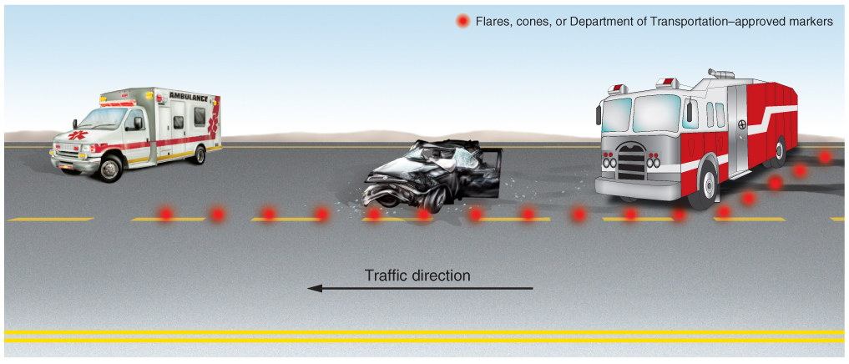
Arrival at the Scene (4 of 6)
FIGURE 38-22 If other responders, such as firefighters or law enforcement officers, are on scene first, park the ambulance about 100 feet (30 m) past the scene on the same side of the road so as to allow an unobstructed departure path.
© Jones & Bartlett Learning.
Notes:
This figure shows safe parking distances for the ambulance.

Slide 31
Arrival at the Scene (5 of 6)
Safe parking (cont’d)
  Stay away from fires, explosive hazards, downed wires, and unstable structures.
  Set the parking brake.
  Facilitate emergency medical care and rapid transport from the scene.
  If it is necessary to block traffic, work quickly and safely.
Notes:
Lecture Outline
g. Stay away from fires, explosive hazards, downed wires, and unstable structures.
h. Set the parking brake.
i. Park as close to the scene as possible to facilitate emergency medical care and rapid transport from the scene.
j. If it is necessary to block traffic to unload equipment or load patients, do so quickly and safely.

Slide 32
Arrival at the Scene (6 of 6)
Traffic control
  Provide care and ensure scene safety first.
  Traffic control is intended to ensure orderly traffic flow, warn other drivers, and prevent another crash.
  Place warning devices on both sides of the crash.
Notes:
Lecture Outline
5. Traffic control
a. Only when all patients have been treated and the emergency situation is under control should you be concerned with restoring the flow of traffic.
b. Traffic control is intended to ensure an orderly traffic flow, warn other drivers, and prevent another crash.
c. As soon as possible, place warning devices (eg, reflectors) on both sides of the crash.

Slide 33
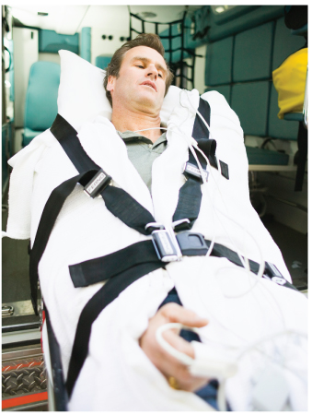
Transfer Phase
The patient must be packaged for transport.
  Secure the patient to a backboard, scoop stretcher, or wheeled ambulance stretcher.
  Lift the patient into the compartment.
  Secure the patient with straps.
FIGURE 38-23 Secure the patient appropriately for protection during transport.
© Jim Craigmyle/Corbis/Getty Images.
Notes:
Lecture Outline
F. The transfer phase
1. The patient must be packaged for transport.
a. Secure the patient to a backboard, scoop stretcher, or wheeled ambulance stretcher.
2. Properly lift the patient into the patient compartment.
3. Secure the patient with at least three straps across the body.
a. Use deceleration or stopping straps over the patient’s shoulders, especially if the patient is lying flat or secured to a backboard.

Slide 34
Transport Phase (1 of 2)
When you are ready to leave with the patient, inform dispatch of:
  Number of patients
  Name of receiving hospital
  Beginning mileage of ambulance
Notes:
Lecture Outline
G. The transport phase
1. Provide dispatch with the following information when you are ready to leave with the patient:
a. Number of patients
b. Name of receiving hospital
c. Beginning mileage of the ambulance (in some jurisdictions)

Slide 35
Transport Phase (2 of 2)
Monitor the patient’s condition en route.
  Recheck a stable patient every 15 minutes.
  Recheck an unstable patient every 5 minutes.
Contact the receiving hospital.
Do not abandon the patient emotionally.
  Be aware of the patient’s level of need.
Notes:
Lecture Outline
2. Monitor the patient’s condition en route.
a. Recheck a stable patient’s vital signs every 15 minutes.
b. Recheck an unstable patient’s vital signs every 5 minutes.
3. Contact the receiving hospital.
4. Do not abandon the patient emotionally.
a. Be aware of the patient’s level of need.
5. Use common sense and defensive driving techniques at all times.

Slide 36
Delivery Phase
Notify dispatch of your arrival at the hospital.
Report your arrival to the triage nurse or other arrival personnel.
Physically transfer the patient.
Present a complete verbal report.
Complete a detailed patient care report.
Restock items, if possible.
Notes:
Lecture Outline
H. The delivery phase
1. Inform dispatch as soon as you arrive at the hospital.
2. Report your arrival to the triage nurse or other arrival personnel.
3. Physically transfer the patient.
4. Present a complete verbal report.
5. Complete a detailed patient care report.
6. Restock items used during the call.

Slide 37
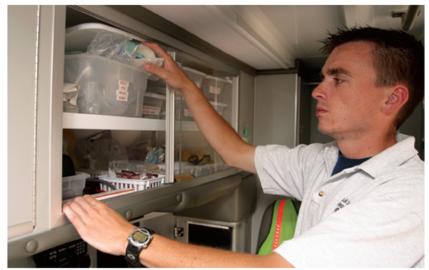
En Route to the Station
Inform dispatch whether you are in service and where you are going.
Back at the station:
  Clean and disinfect the ambulance and equipment.
  Restock supplies.
FIGURE 38-24 After transferring the patient and relating patient information to the hospital staff, you should restock any items that were used during the run.
© Jones & Bartlett Learning. Courtesy of MIEMSS.
Notes:
Lecture Outline
I. En route to the station
1. Inform dispatch whether you are in service and where you are going.
2. As soon as you are back at the station:
a. Clean and disinfect ambulance and equipment, if not already done at the hospital.
b. Restock supplies, if not already done at the hospital.

Slide 38
Postrun Phase (1 of 4)
Complete and file additional written reports.
Inform dispatch again of status, location, and availability.
Perform routine inspections.
Refuel the vehicle.
Notes:
Lecture Outline
J. The postrun phase
1. Complete and file any additional reports and again inform dispatch of your status, location, and availability.
2. This is an appropriate time to debrief following the call.
3. Perform routine ambulance inspections and refuel the vehicle.

Slide 39
Postrun Phase (2 of 4)
Key terms:
  Cleaning
  Disinfection
  High-level disinfection
  Sterilization
Notes:
Lecture Outline
4. Key terms:
a. Cleaning: the process of removing dirt, dust, blood, or other visible contaminants from a surface or equipment
b. Disinfection: the killing of pathogenic agents by directly applying a chemical made for that purpose to a surface or equipment
c. High-level disinfection: the killing of pathogenic agents by the use of potent means of disinfection
d. Sterilization: a process, such as the use of heat, that removes all microbial contamination

Slide 40
Postrun Phase (3 of 4)
After each call:
  Strip linens from the stretcher and place them in a plastic bag or designated receptacle.
  Discard medical waste.
  Wash contaminated areas with soap and water.
Notes:
Lecture Outline
5. After each call, perform the following regimen:
a. Strip used linens from the stretcher and place them in a plastic bag or designated receptacle.
b. Discard medical waste (eg, disposable equipment used for patient care during the call) in an appropriate receptacle.
c. Wash contaminated areas with soap and water.

Slide 41
Postrun Phase (4 of 4)
After each call: (cont’d)
  Disinfect all nondisposable equipment used for patient care.
  Clean the stretcher with germicidal/virucidal solution or 1:100 bleach dilution.
  Clean spillage or other contamination with one of those same solutions.
Notes:
Lecture Outline
d. Disinfect all nondisposable equipment used for patient care during the call.
e. Clean the stretcher with an EPA-registered germicidal/virucidal solution or bleach and water at 1:100 dilution.
f. Clean spillage or other contamination with the same germicidal/virucidal solution or bleach/water solution.

Slide 42
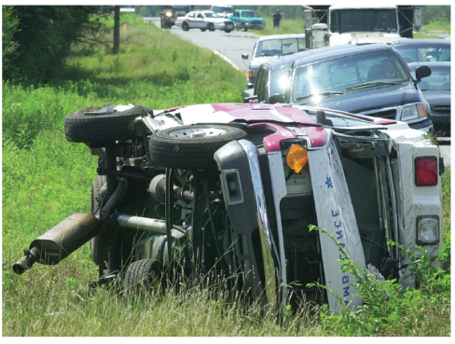
Defensive Ambulance Driving Techniques (1 of 10)
An ambulance involved in a crash delays patient care and may take lives of EMTs, other motorists, or pedestrians.
FIGURE 38-26 Each year, ambulance crashes are the
cause of thousands of injuries to pedestrians, motorists, ambulance passengers, and EMS personnel.
© Gary Lloyd, The Decatur Daily/AP Photos.
Notes:
Lecture Outline
IV. Defensive Ambulance Driving Techniques
An ambulance involved in a crash delays patient care, at a minimum, and, at worst, may take the lives of the EMTs, other motorists, or pedestrians.
1. You are strongly encouraged to participate in a certified defensive driving program before attempting to operate an emergency vehicle.

Slide 43
Defensive Ambulance Driving Techniques (2 of 10)
Driver characteristics
  Some states require an emergency vehicle operations course.
  Other characteristics:
    Physical fitness and alertness
    Emotional maturity and stability
    Due regard for the safety of others and preservation of property
Notes:
Lecture Outline
B. Driver characteristics
1. Physical fitness and alertness are necessary to properly operate an emergency vehicle. You should not be driving if:
a. You take medications that can cause drowsiness or slow your reaction time.
b. You have been drinking alcohol.
c. You have been working long shifts or multiple consecutive shifts.
i. Notify your employer if you have worked a shift previously and feel unable to safely operate an emergency vehicle.
2. Emotional maturity and stability are necessary to operate under stress.
3. You cannot drive in any manner that pleases you simply because you have lights and siren on.
4. You must operate the vehicle with due regard for the safety of others and preservation of property.

Slide 44
Defensive Ambulance Driving Techniques (3 of 10)
Safe driving practices
  Speed does not save lives; good care does.
  Wear seat belts and shoulder restraints.
  Become familiar with how the vehicle accelerates, corners, sways, and stops.
  Stay in the extreme left-hand lane on multilane highways.
Notes:
Lecture Outline
C. Safe driving practices
1. Speed does not save lives; good care does.
2. All drivers and passengers must wear seat belts and shoulder restraints at all times.
a. If you remove your seat belt to provide care, fasten it again as soon as possible.
b. Unrestrained or improperly restrained patients and equipment may become airborne during a collision.
3. Become familiar with how your emergency vehicle accelerates, corners, sways, and stops under various conditions.
4. In a multilane highway, stay in the extreme left-hand (fast) lane, allowing other motorists to move over to the right lane when they see or hear you approach.

Slide 45
Defensive Ambulance Driving Techniques (4 of 10)
Siren risk–benefit analysis
  The decision to activate the emergency lights and siren will depend on:
    Local protocols
    Patient condition
    Anticipated clinical outcome of the patient
Notes:
Lecture Outline
5. Siren risk–benefit analysis
a. The decision to activate the emergency lights and siren will depend on several factors:
i. Local protocols
ii. Patient condition
iii. Anticipated clinical outcome of the patient
b. Consider the patient’s condition before activating emergency lights.
i. Emergency lights and siren noise may increase the patient’s anxiety level.

Slide 46
Defensive Ambulance Driving Techniques (5 of 10)
Driver anticipation
  Always assume that motorists around your vehicle have not heard your siren/public address system or seen you.
  Always drive defensively.
Notes:
Lecture Outline
6. Driver anticipation
a. Always assume that motorists around your vehicle have not heard your siren/public address system or seen you until proven otherwise by their actions.
b. Look at the direction of the other vehicle’s front tires to get an early indication of which way it will turn.
c. Always drive defensively.

Slide 47
Defensive Ambulance Driving Techniques (6 of 10)
Cushion of safety
  Maintain a safe following distance from the vehicles in front of you.
  Try to avoid being tailgated from behind.
  Ensure that the blind spots do not prevent you from seeing vehicles or pedestrians.
  Never get out of the ambulance to confront a driver.
  Be aware of blind spots and scan mirrors frequently.
Notes:
Lecture Outline
7. Cushion of safety
a. Maintain a safe following distance from the vehicles in front of you and try to avoid being tailgated from behind.
b. Ensure that the blind spots in your vehicle’s mirrors do not prevent you from seeing vehicles or pedestrians on either side of the ambulance.
c. To distance yourself from a tailgater, slow down or contact the local police.
d. Never get out of the ambulance to confront a driver.
e. Three blind spots around the ambulance:
i. Rearview mirror creates a blind spot in front of driver
ii. Rear of vehicle cannot be seen fully through the mirror
iii. Side of the vehicle
f. Scan your mirrors frequently for any new hazards and use a spotter and predetermined hand signals when backing up an ambulance.

Slide 48
Defensive Ambulance Driving Techniques (7 of 10)
Excessive speed
  Unnecessary, dangerous, and does not increase the patient’s chance of survival
  Makes it difficult to provide care in the patient compartment
  Hinders the driver’s reaction time
  Increases the time and distance needed to stop the ambulance
Notes:
Lecture Outline
8. Excessive speed
a. Unnecessary, dangerous, and does not increase the patient’s chance of survival.
b. Makes it difficult for EMTs to provide care in the patient compartment
c. Hinders the driver’s reaction time
d. Increases the time and distance needed to stop the ambulance

Slide 49
Defensive Ambulance Driving Techniques (8 of 10)
Siren syndrome
  Causes drivers to drive faster in the presence of siren, due to increased anxiety
Vehicle size and distance judgment
  Crashes often occur when the vehicle is backing up, so use a spotter.
  Size and weight influence braking and stopping distances.
Notes:
Lecture Outline
9. Siren syndrome
a. Causes drivers to drive faster in the presence of siren, due to increased anxiety
b. Although a siren signifies a request for drivers to yield the right-of-way, drivers do not always do so.
10. Vehicle size and distance judgment
a. Vehicle length and width are critical factors when maneuvering, driving, and parking an emergency vehicle.
b. Preventable accidents often occur when the vehicle is backing up.
i. Always use someone outside the ambulance as a ground guide when you are backing up to avoid any incidents.
c. Vehicle size and weight greatly influence braking and stopping distances.

Slide 50
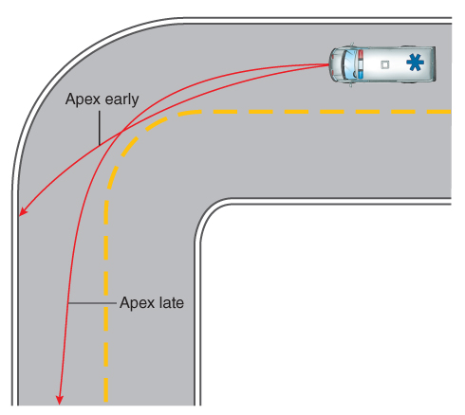
Defensive Ambulance Driving Techniques (9 of 10)
Road positioning and cornering
  To keep the ambulance in the proper lane when turning, enter high in the lane, and exit low.
FIGURE 38-27 To keep the ambulance in the proper lane
on a curve, you must know the vehicle’s current position and
projected path and take the corner at the correct speed.
© Jones & Bartlett Learning.
Notes:
Lecture Outline
11. Road positioning and cornering
a. Road position means the position of the vehicle on the roadway relative to the inside or outside edge of the paved surface.
b. To keep the ambulance in the proper lane when turning a corner, enter high in the lane (to the outside) and exit low (to the inside).

Slide 51
Defensive Ambulance Driving Techniques (10 of 10)
Weather and road conditions
  Ambulances have a longer braking time and stopping distance.
  The weight of the ambulance is unevenly distributed, which makes it more prone to roll over.
  Be alert for hydroplaning, water on the roadway, decreased visibility, and ice and slippery surfaces.
Notes:
Lecture Outline
12. Weather and road conditions
a. Ambulances have a longer braking time and stopping distance.
b. The weight of the ambulance is unevenly distributed, which makes it more prone to roll over.
c. Be alert to changing weather, road, and driving conditions.
d. Hydroplaning
i. At speeds of greater than 30 mph, a tire may lift off the road as water “piles up” under it; the vehicle may then feel as if it is floating.
ii. If hydroplaning occurs, you should gradually slow down without jamming on the brakes.
e. Water on the roadway
i. Wet brakes will not slow the vehicle as efficiently as dry brakes, and the vehicle may pull to one side or the other.
ii. Avoid driving through large pools of standing water or through moving water.
f. Decreased visibility
i. In areas where there is fog, smog, snow, or heavy rain, slow down to a safe operating speed.
ii. Always use headlights during the day.
iii. Watch carefully for stopped or slow-moving vehicles.
g. Ice and slippery surfaces
i. Good all-weather tires and an appropriate speed will reduce traction problems significantly.
ii. Consider using studded snow tires or tire chains, if they are permitted by law.

Slide 52
Laws and Regulations (1 of 5)
If you are on an emergency call and are using your warning lights and siren, you may be allowed to do the following:
  Park or stand in an illegal location
  Proceed through a red light or stop sign
  Drive faster than the speed limit
  Drive against the flow of traffic
  Travel left of center to make an illegal pass
Notes:
Lecture Outline
13. Laws and regulations
a. Although emergency vehicle drivers are exempt from normal vehicle operations during a call, certain laws and regulations must be followed.
i. Motor vehicle crashes account for a large number of lawsuits against EMS personnel and services.
b. If you are on an emergency call and are using your warning lights and siren, you may be allowed to do the following:
i. Park or stand in an otherwise illegal location
ii. Proceed through a red traffic light or stop sign, but never without stopping first
iii. Drive faster than the posted speed limit
iv. Drive against the flow of traffic on a one-way street or make a turn that is normally illegal
v. Travel left of center to make an otherwise illegal pass

Slide 53
Laws and Regulations (2 of 5)
An emergency vehicle is never allowed to pass a school bus that has stopped to load or unload children.
Use of warning lights and siren
  The unit must be on a true emergency call.
  Audible and visual warning devices must be used simultaneously.
  The unit must be operated with regard for others’ safety.
Notes:
Lecture Outline
c. An emergency vehicle is never allowed to pass a school bus that has stopped to load or unload children and is displaying its flashing red lights or extended “stop arm.”
d. Use of warning lights and siren is governed by three basic principles:
i. The unit must be on a true emergency call to the best of your knowledge.
ii. Audible and visual warning devices must be used simultaneously.
iii. The unit must be operated with due regard for the safety of all others.

Slide 54
Laws and Regulations (3 of 5)
Right-of-way privileges
  Emergency vehicles have the right to disregard the rules of the road when responding to an emergency.
  Do not endanger people or property under any circumstances.
  Get to know your local right-of-way privileges.
Notes:
Lecture Outline
e. Right-of-way privileges
i. State motor vehicle statutes or codes often grant an emergency vehicle the right to disregard the rules of the road when responding to an emergency.
ii. In doing so, the operator of an emergency vehicle must not endanger people or property under any circumstances.
iii. Get to know your local right-of-way privileges and exercise them only when it is absolutely necessary for the patient’s well-being.

Slide 55
Laws and Regulations (4 of 5)
Use of escorts
  Use escorts as a guide only when you are in unfamiliar territory.
Intersection hazards
  Intersection crashes are the most common and most serious.
  If you cannot wait for traffic lights to change, come to a brief stop and look for pedestrians or other hazards.
Notes:
Lecture Outline
f. Use of escorts
i. Use police escorts as a guide only when you are in unfamiliar territory.
ii. Vehicles using warning lights or siren should use different tones to alert other motorists and be prepared to stop if needed.
iii. If you are being guided, follow at a safe distance.
g. Intersection hazards
i. Intersection crashes are the most common and usually the most serious type of collision in which ambulances are involved.
ii. Always be alert and careful when approaching intersections.
iii. If you are on an urgent call and cannot wait for traffic lights to change, come to a brief stop at the light and check for other motorists and pedestrians before proceeding.

Slide 56
Laws and Regulations (5 of 5)
Highways
  Shut down emergency lights and siren until you have reached the far left lane.
Unpaved roads
  Operate at a lower speed with a firm grip on the steering wheel.
School zones
  It is unlawful to exceed the speed limit.
Notes:
Lecture Outline
h. Highways
i. Shut down emergency lights and siren until you have reached the far left lane.
ii. When you exit the highway, follow the same procedures as when you entered the highway.
i. Unpaved roadways
i. Take special care.
ii. Operate the vehicle at a lower speed and maintain a firm grip on the steering wheel.
j. School zones
i. It is unlawful for an emergency vehicle to exceed the speed limit in school zones regardless of the condition of the patient.

Slide 57
Distractions
Focus on driving and anticipating roadway hazards.
Minimize distractions from:
  Mobile dispatch terminals and GPS
  Mounted mobile radio
  Stereo
  Cell phone
  Eating/drinking
Notes:
Lecture Outline
14. Distractions
a. While the ambulance is in motion, focus on driving and anticipating roadway hazards.
b. Minimize distractions from:
i. Mobile dispatch terminals and GPS
ii. Mounted mobile radio
iii. Stereo
iv. Cell phone
v. Eating/drinking

Slide 58
Driving Alone
It is your responsibility to focus on figuring out the safest route while mentally preparing for the call.
Such situations demand your complete attention and focus.
Notes:
Lecture Outline
15. Driving alone
a. When driving alone, it is your responsibility to focus on figuring out the safest route while mentally preparing for the call.
b. Such situations demand your complete attention and focus.

Slide 59
Fatigue
Recognize when you are fatigued and alert your partner or supervisor.
You should be placed out of service for the remainder of the shift or until the fatigue has passed and you feel capable of operating the vehicle safely.
Notes:
Lecture Outline
16. Fatigue
a. Recognize when you are fatigued and alert your partner or supervisor.
b. If you are feeling fatigued, you should be placed out of service for the remainder of the shift or until the fatigue has passed and you feel capable of operating the vehicle safely.

Slide 60
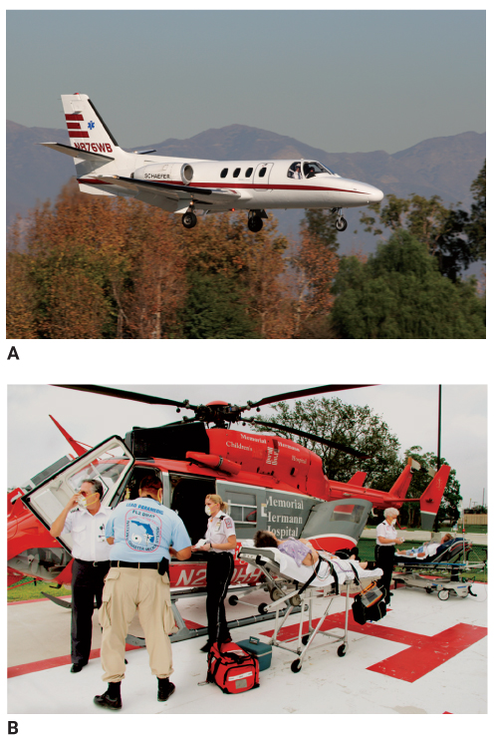
Air Medical Operations (1 of 11)
Air ambulances are used to evacuate medical and trauma patients.
  Fixed-wing units
  Rotary-wing units (helicopters)
FIGURE 38-29 A. Fixed-wing aircraft are generally used
to transfer patients from one hospital to another over
distances greater than 200 to 250 miles. B. A rotary-wing
aircraft, or helicopter, is used to help provide emergency
medical care to patients who need to be transported
quickly over shorter distances.
A: © Ralph Duenas/www.jetwashimages.com; B: Courtesy of Ed Edahl/FEMA.
Notes:
Lecture Outline
V. Air Medical Operations
A. Air ambulances are used to evacuate medical and trauma patients.
1. Fixed-wing units are used for interhospital patient transfers over distances greater than 200 to 250 miles.
2. Rotary-wing units (helicopters) are more efficient for shorter distances.

Slide 61
Air Medical Operations (2 of 11)
Specially trained crews accompany air ambulance flights.
  EMTs provide ground support.
Medical evacuation (medevac) is performed by helicopters.
  Capabilities, protocols, and procedures vary.
Notes:
Lecture Outline
B. Specially trained crews accompany air ambulance flights.
1. The EMT’s duties are limited to providing ground support.
C. Helicopter medical evacuation operations
1. Medical evacuation (medevac) is performed exclusively by helicopters.
2. Capabilities, protocols, and procedures vary between EMS systems.

Slide 62
Air Medical Operations (3 of 11)
Why call for a medevac?
  Transport time by ground is too long.
  Road, traffic, or environmental conditions prohibit the use of ground transport.
  The patient requires advanced care.
  Multiple patients will overwhelm the resources at the hospital reachable by ground transport.
Notes:
Lecture Outline
3. Calling for a medevac
a. Why call for a medevac?
i. The transport time to the hospital by ground is too long considering the patient’s condition.
ii. Road, traffic, or environmental conditions prohibit the use of a ground ambulance.
iii. The patient requires advanced care beyond EMT capabilities.
iv. There are multiple patients who will overwhelm the resources at the hospital reachable by ground transport.

Slide 63
Air Medical Operations (4 of 11)
Who receives a medevac?
  Patients with time-dependent injuries or illnesses
  Patients with stroke, heart attack, or spinal cord injury
  SCUBA diving accidents, near-drownings, or skiing and wilderness accidents
  Trauma patients
  Candidates for limb replantation, burn center, hyperbaric chamber, or venomous bite center
Notes:
Lecture Outline
b. Who receives a medevac?
i. Patients with time-dependent injuries or illnesses
ii. Patients suspected of having a stroke, heart attack, or serious spinal cord injury
iii. Patients who are found in remote areas and have experienced SCUBA diving accidents, near-drownings, or skiing and wilderness accidents
iv. Trauma patients
v. Candidates for limb replantation, a burn center, a hyperbaric chamber, or a venomous bite center

Slide 64
Air Medical Operations (5 of 11)
Whom do you call?
  Generally, the dispatcher should be notified first.
  In some regions, EMS may be able to communicate with the flight crew after initiating the medevac request.
Notes:
Lecture Outline
c. Whom do you call?
i. Generally, the dispatcher should be notified first.
ii. In some regions, EMS may be able to communicate with the flight crew after initiating the medevac request.

Slide 65
Air Medical Operations (6 of 11)
Establish a landing zone.
  Hard or grassy level surface between 60 × 60 feet and 100 × 100 feet (recommended)
  Cleared of loose debris
  Clear of overhead or tall hazards
  Mark the landing site using cones or vehicles.
    Never use caution tape or people to mark the site.
    Do not use flares.
Notes:
Lecture Outline
D. Establishing a landing zone
1. The safest and most effective way to land and take off is similar to that used by fixed-wing aircraft.
a. Landing at a slight angle allows for safer operations.
2. Establishing a landing zone is the responsibility of the ground EMS crew.
3. An appropriate site for a landing zone should be:
a. A hard or grassy level surface 100 × 100 feet (recommended) and no less than 60 × 60 feet
b. Cleared of loose debris
c. Clear of overhead or tall hazards
4. Mark the landing site using weighted cones or emergency vehicles positioned at the corners of the landing zone with headlights facing inward to form an X.
a. Never use caution tape or ask people to mark the site.
b. Do not use flares.

Slide 66
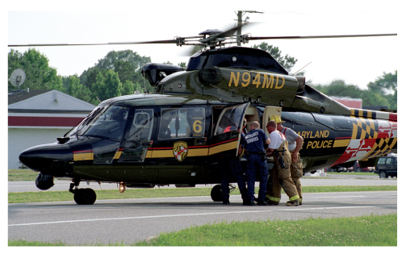
Air Medical Operations (7 of 11)
Establish a landing zone (cont’d)
  Move nonessential persons and vehicles.
  Communicate the direction of strong wind to the flight crew.
FIGURE 38-30 A landing area for an EMS helicopter should be a level surface measuring 100 ft × 100 ft (30 m × 30 m).
© Mark C. Ide.
Notes:
Lecture Outline
5. Move nonessential persons and vehicles to a safe distance outside the landing zone.
6. Communicate the direction of strong wind to the flight crew.

Slide 67
Air Medical Operations (8 of 11)
Landing zone safety and patient transfer
  Keep a safe distance from the aircraft whenever it is on the ground and “hot.”
  Stay away from the tail rotor.
  Always approach the helicopter from the front.
Notes:
Lecture Outline
E. Landing zone safety and patient transfer
1. Stay away from the helicopter and go only where the pilot or crew member directs you.
2. Keep a safe distance from the aircraft whenever it is on the ground and “hot,” which means the helicopter blades are spinning.
3. Stay outside the landing zone perimeter unless directed to come to the aircraft by a member of the flight crew.
4. If you are asked to enter the landing zone, stay away from the tail rotor; the tips of its blades move so rapidly that they are invisible.
5. Always approach the helicopter from the front, even if it is not running.
a. Approach only after the pilot or a flight crew member signals it is clear to do so.
b. Enter only the area between 10 o’clock and 2 o’clock positions.
c. Never duck under the body, the tail boom, or rear section of the helicopter.
6. When you approach the aircraft, walk in a crouched position.

Slide 68
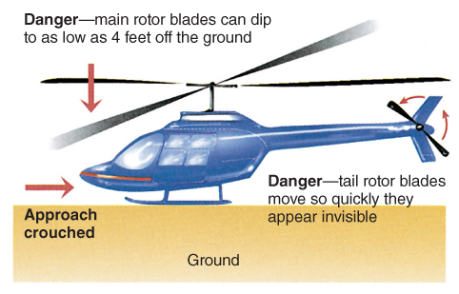
Air Medical Operations (9 of 11)
FIGURE 38-31 The main rotor blade of the helicopter is flexible and may dip as low as 4 feet (1.2 m) off the ground depending on the type of helicopter.
© Jones & Bartlett Learning.
Notes:
This figure shows the danger zones surrounding a helicopter.

Slide 69
Air Medical Operations (10 of 11)
Keep the following guidelines in mind:
  Become familiar with hand signals.
  Do not approach the helicopter unless instructed and accompanied by flight crew.
  Make certain that all equipment and the patient are secured to the stretcher.
  Smoking, open lights or flames, and flares are prohibited within 50 feet.
  Wear eye protection.
Notes:
Lecture Outline
7. Keep the following guidelines in mind when operating at a landing zone:
a. Become familiar with your jurisdiction’s helicopter hand signals.
b. Do not approach the helicopter unless instructed and accompanied by flight crew.
c. Make certain that all patient care equipment and the patient are properly secured to the stretcher.
d. Some helicopters may load patients from the side, whereas others have rear-loading doors.
e. Smoking, open flames, and flares are prohibited within 50 feet of the aircraft at all times.
f. Wear eye protection during approach and take-off.
8. Communication issues
a. In your medevac request, to prevent communication issues, include a ground contact radio channel and call sign of the unit the medevac should make contact with.

Slide 70
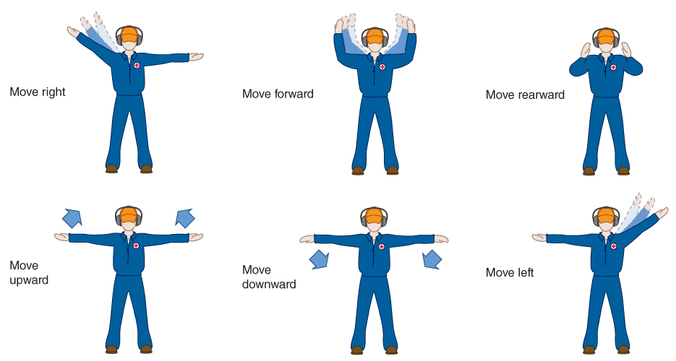
Air Medical Operations (11 of 11)
FIGURE 38-32 Some examples of helicopter hand signals. Be familiar with those used within your jurisdiction.
© Jones & Bartlett Learning.
Notes:
This figure shows the hand signals used around helicopters.

Slide 71
Special Considerations (1 of 3)
Night landings
  Do not shine spotlights, flashlights, or any other lights in the air to help the pilot.
  Direct low-intensity headlights or lanterns toward the ground.
  Illuminate overhead hazards or obstructions, if possible.
Notes:
Lecture Outline
F. Special considerations
1. Night landings
a. Do not shine spotlights, flashlights, or any other lights in the air to help the pilot; they may temporarily blind the pilot.
b. Direct low-intensity headlights or lanterns toward the ground at the landing site.
c. Illuminate overhead hazards or obstructions if possible.

Slide 72
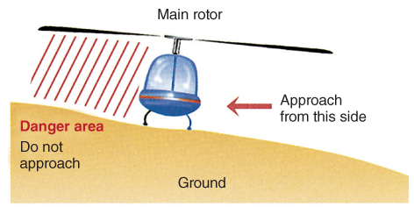
Special Considerations (2 of 3)
Landing on uneven ground
  The main rotor blade will be closer to the ground on the uphill side.
  Approach from the downhill side only.
FIGURE 38-33 Approach a helicopter on a grade only
from the downhill side.
© Jones & Bartlett Learning.
Notes:
Lecture Outline
2. Landing on uneven ground
a. If a helicopter must land on uneven ground, use extra caution.
b. The main rotor blade will be closer to the ground on the uphill side.
c. Approach the aircraft from the downhill side only or as directed by the flight crew.

Slide 73
Special Considerations (3 of 3)
Medevacs at hazmat incidents
  Notify the flight crew.
  Consult about the best approach and distance from the scene.
  Landing zone should be uphill and upwind.
  Decontaminate patients before loading them into the helicopter.
Notes:
Lecture Outline
3. Medevacs at hazmat incidents
a. Immediately notify the flight crew of the presence of hazmat at the scene.
b. Consult the flight crew and incident commander about the best approach and distance from the scene for a medevac.
c. The landing zone should be uphill and upwind from the hazmat scene.
d. Properly decontaminate patients before loading them into the helicopter.

Slide 74
Medevac Issues (1 of 2)
Assess the severity of the weather or environment/terrain.
Most helicopters are limited to flying below 10,000 feet above sea level.
Medevac helicopters fly between 130 and 150 mph.
Notes:
Lecture Outline
G. Medevac issues
1. Factors that influence the decision to request a medevac:
a. Assess the severity of the weather or environment/terrain.
b. Most helicopter services are limited to flying below 10,000 feet above sea level.
c. Medevac helicopters fly between 130 and 150 mph.

Slide 75
Medevac Issues (2 of 2)
Because of the cabin’s confined space, assess the number and size of the patients who can be safely transported in a medevac helicopter.
Typical medevac flights are extremely expensive compared to ambulance transports.
Notes:
Lecture Outline
d. Because of the cabin’s confined space, assess the number and size of the patients who can be safely transported in a medevac helicopter.
e. Medevac flights are extremely expensive compared to ambulance transports.

Slide 76
Review
All of the following are examples of standard patient transfer equipment, EXCEPT:
  Stokes baskets.
  long backboards.
  wheeled stair chairs.
  wheeled ambulance stretchers.

Slide 77
Review
Answer: A
Rationale: Each ambulance should carry a primary wheeled ambulance stretcher, a wheeled stair chair for use in narrow spaces, a long backboard, and a short backboard or short immobilization device. A Stokes basket—also called a basket stretcher—is a specialized piece of equipment that is used for moving patients up or down rough terrain. Most ambulances do not carry Stokes baskets; they are usually carried by rescue vehicles or fire apparatus.

Slide 78
Review
All of the following are examples of standard patient transfer equipment, EXCEPT:
  Stokes baskets.
  Rationale: Correct answer
  long backboards.
  Rationale: This is a standard piece of patient transfer equipment.
  wheeled stair chairs.
  Rationale: This is a standard piece of patient transfer equipment.
  wheeled ambulance stretchers.
  Rationale: This is a standard piece of patient transfer equipment.

Slide 79
Review
The primary purpose of a “jump kit” is to:
  ensure that you have immediate access to the AED.
  have available all of the equipment that you will use in the entire call.
  have easy access to manage patients with severe uncontrolled bleeding.
  have available all of the equipment that will be used in the first 5 minutes.

Slide 80
Review
Answer: D
Rationale: Think of a jump kit as the “5-minute kit,” containing anything you might need in the first 5 minutes with the patient. It is during this 5-minute period that you will find and manage immediate life threats.

Slide 81
Review
The primary purpose of a “jump kit” is to:
  ensure that you have immediate access to the AED.
  Rationale: A jump kit should have the basic equipment to treat immediate life threats. BLS care can be initiated until an AED arrives.
  have available all of the equipment that you will use in the entire call.
  Rationale: You need only the equipment to manage immediate life threats during the first 5 minutes. Afterward, additional equipment can be brought to the scene.
  have easy access to manage patients with severe uncontrolled bleeding.
  Rationale: A jump kit should have the basic equipment to manage all immediate life threats—including airway and breathing.
  have available all of the equipment that will be used in the first 5 minutes.
  Rationale: Correct answer

Slide 82
Review
You have been dispatched to a call for an unresponsive patient. What is the MOST important information that you should obtain from the dispatcher initially?
  The callback number of the caller
  The severity of the patient’s problem
  Whether the patient is breathing
  The exact physical location of the patient

Slide 83
Review
Answer: D
Rationale: All of the choices listed in this question are important questions to ask the dispatcher. However, you must first determine the exact location of the patient. You cannot help the patient if you cannot find him or her. While en route, you should try to ascertain more specific patient information (eg, whether the patient is breathing).

Slide 84
Review
You have been dispatched to a call for an unconscious patient. What is the MOST important information that you should obtain from the dispatcher initially?
  The callback number of the caller
  Rationale: This is important, but not the most important piece of information.
  The severity of the patient’s problem
  Rationale: This is important, but not the most important piece of information.
  Whether the patient is breathing
  Rationale: This is important, but not the most important piece of information.
  The exact physical location of the patient
  Rationale: Correct answer

Slide 85
Review
While en route to a call for a major motor vehicle collision, the MOST important safety precaution(s) that you and your partner can take is/are:
  adhering to standard precautions.
  ensuring that the fire department arrives before you.
  using lights and siren and being aware of other drivers.
  wearing seat belts and shoulder harnesses at all times.

Slide 86
Review
Answer: D
Rationale: The “en route to the scene” phase of a call is the most dangerous. Regardless of the nature of the call to which you are responding, wearing seat belts and shoulder harnesses is the most important safety precaution that you and your partner must take. Furthermore, you must drive defensively and remain aware of the traffic around you.

Slide 87
Review
While en route to a call for a major motor vehicle collision, the MOST important safety precaution(s) that you and your partner can take is/are:
  adhering to standard precautions.
  Rationale: This takes place once the providers arrive at the scene.
  ensuring that the fire department arrives before you.
  Rationale: It is important to know if the fire department is responding, but this is not the most important safety precaution.
  using lights and siren and being aware of other drivers.
  Rationale: The use of lights and siren adds to the risk potential, but the use of safety devices is the most important precaution that you can take.
  wearing seat belts and shoulder harnesses at all times.
  Rationale: Correct answer

Slide 88
Review
Which of the following is NOT a guideline for safe ambulance driving?
  Always use your siren if you have the emergency lights on.
  Always exercise due regard for person and property.
  Use one-way streets whenever possible.
  Go with the flow of the traffic.

Slide 89
Review
Answer: C
Rationale: Avoid one-way streets; they may become clogged. Do not go against the flow of traffic on a one-way street, unless absolutely necessary.

Slide 90
Review
Which of the following is NOT a guideline for safe ambulance driving:
  Always use your siren if you have the emergency lights on.
  Rationale: This is a guideline for safe ambulance driving.
  Always exercise due regard for person and property.
  Rationale: This is a guideline for safe ambulance driving.
  Use one-way streets whenever possible.
  Rationale: Correct answer
  Go with the flow of the traffic.
  Rationale: This is a guideline for safe ambulance driving.

Slide 91
Review
At what speed will the ambulance begin to hydroplane when there is water present on the roadway?
  25 mph
  30 mph
  40 mph
  50 mph

Slide 92
Review
Answer: B
Rationale: At speeds of 30 mph or greater, the tires can lift off the pavement as water “piles up” under the tires. This takes the control out of the driver's hands. If hydroplaning occurs, you should gradually slow down instead of jamming on the brakes to avoid losing control of the vehicle.

Slide 93
Review
At what speed will the ambulance begin to hydroplane when there is water present on the roadway?
  25 mph
  Rationale: This is below the speed where the risk of hydroplaning exists.
  30 mph
  Rationale: Correct answer
  40 mph
  Rationale: This exceeds the speed at which hydroplaning can occur.
  50 mph
  Rationale: This exceeds the speed at which hydroplaning can occur.

Slide 94
Review
The most common and often most serious ambulance crashes occur at/on:
  stop lights.
  intersections.
  highways.
  stop signs.

Slide 95
Review
Answer: B
Rationale: Most serious ambulance crashes occur at intersections. Always be alert and careful when approaching an intersection. Whether at an intersection with stop lights or stop signs, you should momentarily come to a complete stop, look in both directions for other motorists or pedestrians, and then carefully proceed through the intersection.

Slide 96
Review
The most common and often most serious ambulance crashes occur at/on:
  stop lights.
  Rationale: Stop lights are associated with an intersection. The ambulance must come to a complete stop, since most accidents occur at intersections.
  intersections.
  Rationale: Correct answer
  highways.
  Rationale: Highways are not the most common site of ambulance crashes.
  stop signs.
  Rationale: Stop signs are associated with an intersection. The ambulance must come to a complete stop, since most accidents occur at intersections.

Slide 97
Review
The recommended dimensions for a helicopter landing zone are:
  50 × 50 feet.
  75 × 75 feet.
  100 × 100 feet.
  150 × 150 feet.

Slide 98
Review
Answer: C
Rationale: The recommended dimensions for a helicopter landing zone are 100 × 100 feet on a hard or grassy surface that is level. The landing zone should be clear of loose debris and power lines.

Slide 99
Review
The recommended dimensions for a helicopter landing zone are:
  50 × 50 feet.
  Rationale: This is smaller than the recommended dimensions.
  75 × 75 feet.
  Rationale: This is smaller than the recommended dimensions.
  100 × 100 feet.
  Rationale: Correct answer
  150 × 150 feet.
  Rationale: This is significantly larger than the recommendations and may not be a practical size in many emergency operations.

Slide 100
Review
Which of the following statements about helicopters is true?
  It is possible that the main rotor blade will dip to within 4 feet of the ground.
  A helicopter is considered “hot” when it is on the ground and the rotors are still.
  If the helicopter must land on a grade, you should approach it from the uphill side.
  If you must go from one side of the helicopter to the other, the best way is to duck under the body.

Slide 101
Review
Answer: A
Rationale: Because the main rotor blade of a helicopter is flexible, it can dip as low as 4 feet from the ground. Use extreme caution when approaching a helicopter with the rotors on. If the helicopter must land on a grade, approach it from the downhill side. When moving from one side of the helicopter to the other, move around the front of the aircraft—not under it and certainly not behind it!

Slide 102
Review
Which of the following statements about helicopters is true?
  It is possible that the main rotor blade will dip to within 4 feet of the ground.
  Rationale: Correct answer
  A helicopter is considered “hot” when it is on the ground and the rotors are still.
  Rationale: It is considered “hot” when the rotors are turning.
  If the helicopter must land on a grade, you should approach it from the uphill side.
  Rationale: You must approach the helicopter from the downhill side.
  If you must go from one side of the helicopter to the other, the best way is to duck under the body.
  Rationale: You must go from one side to the other around the front of the helicopter—never go behind it.

Slide 103
Review
Upon arrival at a scene where hazardous materials are involved, you should park the ambulance:
  upwind from the scene.
  with the warning lights off.
  downhill from the scene.
  at least 50 feet from the scene.

Slide 104
Review
Answer: A
Rationale: At the scene of a hazmat incident, the ambulance should be parked uphill and upwind from the scene. Other locations may expose the ambulance to any escaping hazardous material. Be prepared to quickly move the ambulance if the wind shifts in your direction.

Slide 105
Review
Upon arrival at a scene where hazardous materials are involved, you should park the ambulance:
  upwind from the scene.
  Rationale: Correct answer
  with the warning lights off.
  Rationale: Parking upwind is your most important concern. Using the warning lights is based upon departmental guidelines.
  downhill from the scene.
  Rationale: You should park uphill and upwind.
  at least 50 feet from the scene.
  Rationale: Parking upwind is your first priority. The distance from the hot zone should be at least 100 feet.

